Slide 1

Advanced React Course
Ynon Perek

Slide 2
Agenda
How React Works
Performance
Hooks Best Practices
Redux
React Testing Library

Slide 3

React History & Culture
Created by Jordan Walke at Facebook (who has since left)
2011 - first deployed in FB
May 29, 2013 (JS Conf US) - initial public release (0.3.0)
Latest Version: 18.2.0

Slide 4
Philosophy
Entirely Declarative
Render – describe your view at any point in time
Escape Hatches – so you can integrate other tools

Slide 5
How React Works: The Virtual DOM
function App() {
return (
<main>
<h1>Page Header</h1>
<p>a long block of
<span className="highlight">text</span>
about React
</p>
</main>
)}

Slide 6
How React Works: The Virtual DOM
function App() {
return (
React.createElement("main", null,
React.createElement("h1", null, "Page Header"),
React.createElement("p", null,
"a long block of ",
React.createElement("span", { className: "highlight" }, "text"),
" about React")));
}

Slide 7
Change Detection
What Is State?
Demo: Todo App with item state (done)

Slide 8
Change Detection
Where is state saved?
Demo: Todo App with item state (done)

Slide 9
Change Detection
Tip: Select component according to state

Slide 10
State Best Practices
Example: Money Converter: https://codesandbox.io/s/brave-moon-71dcvl
Example: https://codesandbox.io/s/long-platform-gnjg9f

Slide 11

Q & A

Slide 12
Agenda
How React Works
Performance
Hooks Best Practices
Redux
React Testing Library

Slide 13

React Performance

Slide 14
What Is Performance?

Slide 15
Performance
Load Speed
Responsiveness
Perceived Performance

Slide 16
React Can Affect All 3
Load Speed
Responsiveness
Perceived Performance

Slide 17
We’ll Focus On Responsiveness
What makes an app feel “laggy” ?

Slide 18
We’ll Focus On Responsiveness
Delay | User Reaction
0 – 100ms | Instant
100 - 300 ms | Feels sluggish
300 - 1000 ms | Machine is working
1s+ | Context switching
10s+ | Comes back later

Slide 19
What Affects Page Performance
Number of renders
Size of document
Demo: filter large list

Slide 20
What Affects Page Performance
Render Counting
When is a component rendered?
Demo: Render Counts, Memo https://codesandbox.io/s/bold-firefly-wttz4

Slide 21
Performance Lab: Colored Boxes

Slide 22
Takeaways
Group to components based on state
Put together items that change together
Use deferred values to improve performance when appropriate
Always stay on top of your renders

Slide 23
React Suspense
import React, { Suspense } from 'react';
const OtherComponent = React.lazy(() => import('./OtherComponent'));
function MyComponent() {
return (
<div>
<Suspense fallback={<div>Loading...</div>}>
<OtherComponent />
</Suspense>
</div>
);
}

Slide 24
React Suspense For Data Fetching
Fetch data as you render
Example here: https://codesandbox.io/s/frosty-hermann-bztrp?file=/src/index.js
Not yet stable

Slide 25
Will Be Great with useTransition
Before: https://codesandbox.io/s/headless-frog-gnvwbt
After: https://codesandbox.io/s/clever-neumann-npcgx1

Slide 26
Careful with that Global Data Eugene
Concurrent Mode can cause render tearing, if it directly accesses global data
Demo: https://codesandbox.io/s/old-pond-6yvfu6?file=/src/App.js
Fix: https://codesandbox.io/s/serverless-dust-s5qigk

Slide 27
Q & A

Slide 28
Agenda
How React Works
Performance
Hooks Best Practices
Redux
React Testing Library

Slide 29
useEffect: How To Use
useEffect(function effect() {
// connect to external resource
return function cleanup() {
// disconnect from external resource }
}, [...dependencies])

Slide 30
useEffect Best Practices
React
External ”Thing”
useEffect

Slide 31
useEffect Examples
https://github.com/streamich/react-use/blob/master/src/useMouse.ts
https://github.com/craig1123/react-recipes/blob/master/src/useDarkMode.js

Slide 32
Lab: Common Pitfalls with useEffect

Slide 33
Takeaways: useEffect
Remember your dependencies
Performance: don’t use an effect where you can use a computed value
Always use a cleanup function

Slide 34
useEffect Tips
Replace function dependencies with useReducer
Put function dependencies inside effects
Make effects Self-Sufficient
Extra Reading: https://overreacted.io/a-complete-guide-to-useeffect/

Slide 35
Q & A

Slide 36
useRef
A “static” variable, saving its value in between renders
Similar to state, but changes don’t cause re-render
Often used to refer to DOM nodes in the `ref={…}` syntax

Slide 37
Demo: Ref and State
Use a ref to store clicks count
Use a state to store clicks count
Note how state change => re-render, while ref don’t

Slide 38
Demo: Portals and Refs
Share state with outside component using a ref and a portal
Outside component passes in the DOM node, and inner component paints to it using a portal
Use an effect to synchronise
Don’t use in real life …

Slide 39
Forward Ref
const FancyButton = React.forwardRef((props, ref) => (
<button ref={ref} className="FancyButton">
{props.children}
</button>
));
// You can now get a ref directly to the DOM button:
const ref = React.createRef();
<FancyButton ref={ref}>Click me!</FancyButton>;

Slide 40
Ref Lab
Create a component that shows 4 input fields on the page. After a user writes 5 characters in one input the focus automatically changes to the next one.
Create a form that has 3 input fields: name, email and password; and a “submit” button When the user clicks on submit print out a JSON with all the data in the form. Use ref to get the data only when submit is clicked

Slide 41
Ref Lab
Wrap rateYo jQuery plugin as a React Component: https://rateyo.fundoocode.ninja
The component should take the props:
ratedFill
value (how many stars)
onChange (callback to handle user changed the number of stars)

Slide 42
Error Boundaries
Used to show an error to the user when an exception happens inside render or inside an effect
Like a try/catch for render

Slide 43
Demo: Error Catcher

Slide 44
Takeaways: Error Boundaries
Always use at least one error boundary
Error boundary should allow a user to “fix” the situation
Can use multiple error boundaries when different areas of the page can break at different times

Slide 45
Other Hooks - useId
export default function App() {
const [value, setValue] = useState(false);
const id = useId();
return (
<>
<input
type="checkbox"
checked={value}
onChange={(e) => setValue(e.currentTarget.checked)}
id={id}
/>
<label htmlFor={id}>Toggle</label>
</>
);
}

Slide 46
Custom Hooks
Custom Hooks are just functions
They wrap normal hooks
They start with ”use”
They are the key to stateful code reuse between components

Slide 47
Lab: Custom Hooks
Implement a hook called “useLocalState” that takes a key and an initial value, returns a state variable but also saves that variable to local storage using the provided key
Usage:
const [value, setValue] = useLocalState(42);

Slide 48
Lab: Custom Hooks
Create two hooks: `useRemoteData` and `useIsLoading`
useRemoteData(url) -> sends a fetch request to the provided URL, and returns the result as JSON
useIsLoading() -> returns a boolean value indicating if anywhere in the app there are active requests initiated by useRemoteData
Starter: https://codesandbox.io/s/brave-beaver-mfskfc?file=/src/App.js

Slide 49
Q & A

Slide 50
Agenda
How React Works
Performance
Hooks Best Practices
Redux
React Testing Library

Slide 51

Redux

Slide 52
Redux Provides:
Global Data
Actions => Changes to the data

Slide 53
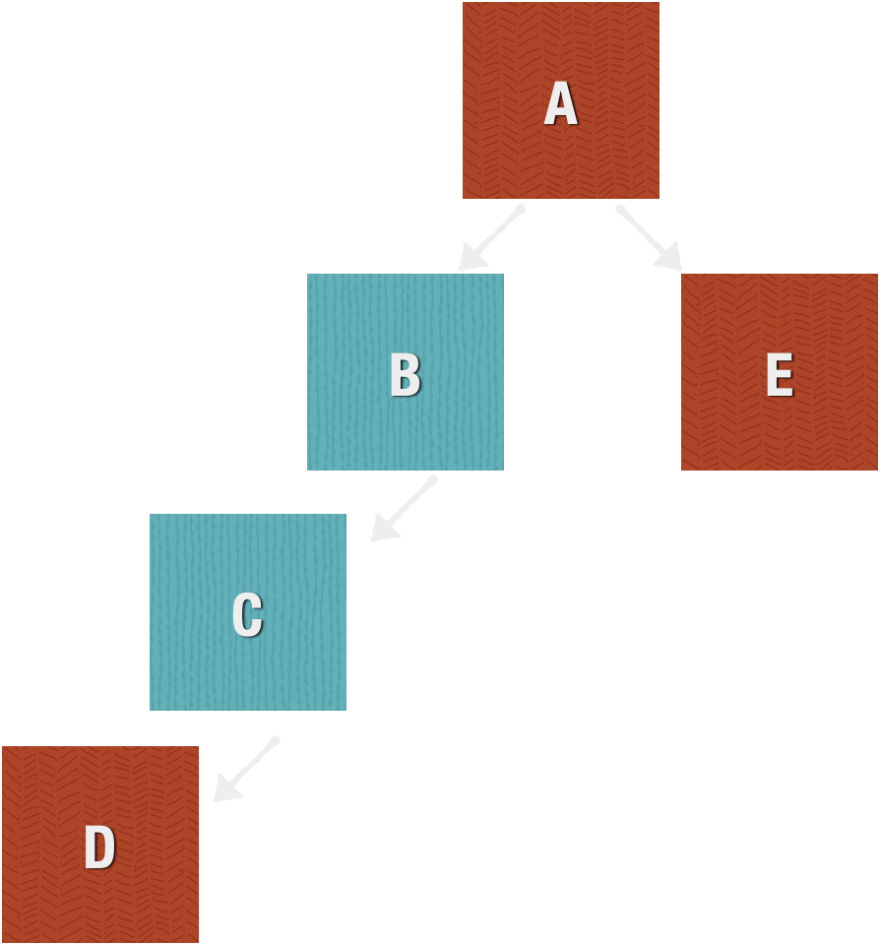
React Data Flow
Components have state
Propogate state from parent to children

Slide 54
Flux Data Flow
Store - Global Data
Store provides data to components all around
Users Store
Meetings Store

Slide 55
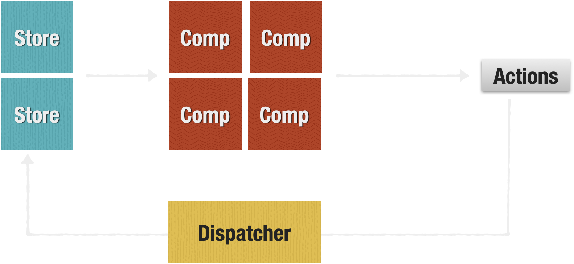
Flux Data Flow
Global state is saved in stores
Actions update stores through a dispatcher

Slide 56
Why Does flux need multiple stores?

Slide 57
Nested Data and Change Detection
Meetings Store
meetings = [
{ id: 1, name: 'daily', participants: [2, 5, 9] },
{ id: 2, name: 'daily', participants: [1, 4] },
{ id: 4, name: 'code review', participants: [1, 4] },
{ id: 5, name: 'surprise', participants: [1, 8] },
]

Slide 58
Nested Data and Change Detection
Meetings Store
function subscribe(cb) {
// adds cb to the list of subscribers
// run cb every time the data changes
// cb doesn’t KNOW what has changed
}

Slide 59

Enter Redux
Created by Dan Abramov and Andrew Clark in 2015
Is considered one of the main 3 options to manage global state, along with MobX and Context
Dan Abramov joined facebook in 2016 to work on React

Slide 60
Redux Concepts
One store - Single source of truth
State is read-only
Changes are made with pure functions
Change Detection via Immutable Data

Slide 61
Redux Illustrated
Store
Action
Store
Action
Store

Slide 62
Immutable Data

Slide 63
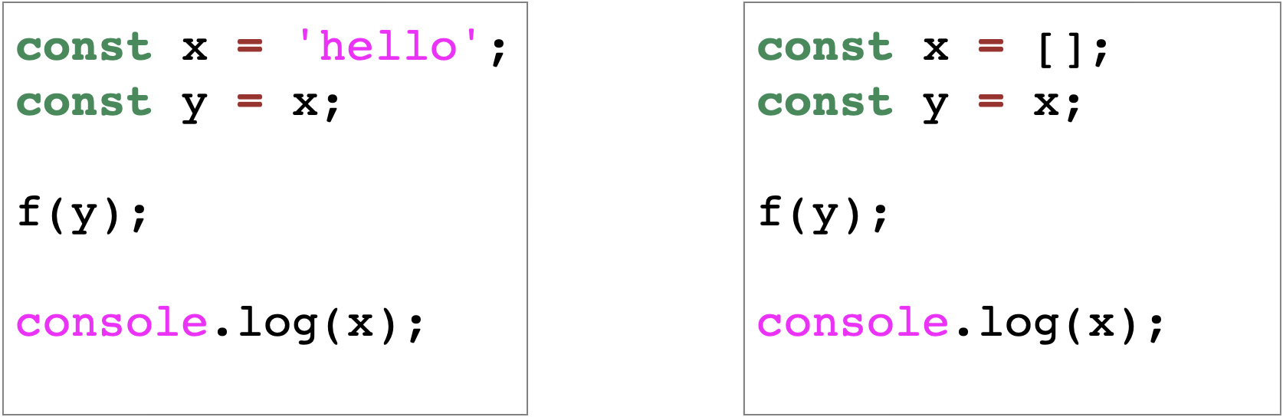
JavaScript: Mutable vs. Immutable

Slide 64
JavaScript: Mutable vs. Immutable
const data = {
projects: [
{
name: 'Learn Immutable Data’,
tasks: [
{ id: 1, text: '...', done: false },
{ id: 2, text: '...', done: false },
{ id: 3, text: '...', done: false },
{ id: 4, text: '...', done: false },
]
}
]
}

Slide 65
Mutable Change
data.projects[0].tasks[2].done = true

Slide 66
Immutable Change
const newData = {
...data,
projects: [
{ ...data.projects[0], tasks: [
...data.projects[0].tasks.slice(0, 2),
{ ...data.projects[0].tasks[2], done: true },
...data.projects[0].tasks.slice(3),
]},
...data.projects.slice(1),
]
}

Slide 67
Immutable Changes with Immer
const newData = produce(data, draft => {
draft.projects[0].tasks[2].done = true;
})

Slide 68
Demo: Redux Chat App
Actions:
setUsername
receivedMessage
createRoom
setActiveRoom
receivedRooms

Slide 69
Demo: Moving to RTK
Account slice
Rooms and messages slice

Slide 70
Demo: Connect React UI
Install react-redux
Provider
useSelector, useDispatch
Redux dev tools

Slide 71
Demo: Advanced Actions
Actions shared between slices
Prepare actions
Async Thunks

Slide 72
Redux Lab
https://www.tocode.co.il/bundles/react/lessons/redux-lab-1

Slide 73
Demo: Redux Middlewares
What’s a middleware
Logger Middleware
Freeze Middleware

Slide 74
Demo: Add Firebase to actually chat
What’s Firebase
Starter code
Message Send Component
Get messages to redux store

Slide 75
Redux Middlewares Lab
https://www.tocode.co.il/bundles/react/lessons/redux-middlewares-lab

Slide 76
RTK Query
Demo: Create an interface to read notes https://www.tocode.co.il/blog/2022-10-rtk-query-intro
Lab: Add endpoints and interface to create new notes

Slide 77
Q & A

Slide 78
Agenda
How React Works
Performance
Hooks Best Practices
Redux
React Testing Library

Slide 79
React Testing Library

Slide 80

Why Test Your Code?

Slide 81
Some Code is harder to test manually
Specific use cases
Special setup
Communication with external service
Paid flow

Slide 82
Manual testing might not be that effective
It’s hard to test the same things manually (so we skip)
Manual testing takes time, every time
Manual testing is error prone

Slide 83
How can automatic tests help you
It’s in addition, not instead of manually “playing” with the code
It can create setups and scenarios that are hard to create manually
It executes the same way every time

Slide 84
Types of tests
Unit tests
Integration tests
Security tests
Accessibility tests
Load tests
End to end tests

Slide 85
Demo: Testing React Component
Create
Create a new app with create-react-app
Read
Read App.test.js
Change
Change the code and the test
Run
Run the test from Terminal and from VS Code

Slide 86
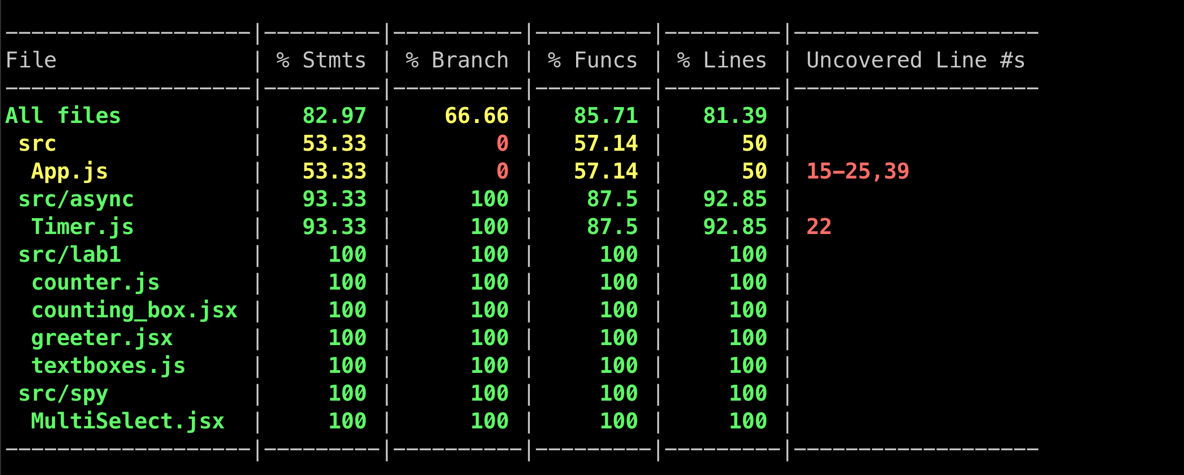
Test Coverage
npm run test -- --coverage

Slide 87
Lab: Testing Simple Components
https://gist.github.com/ynonp/c51e7ece764eae6e66f862b192d28e49

Slide 88
Testing Library Queries
getBy / getAllBy
findBy / findAllBy
queryBy / queryAllBy

Slide 89
Testing Library Queries – By Role
screen.getByRole('button', { name: 'Add' });
Role Examples:
Role | Matches
link | <a href=“…” />
textbox | <input type=“text” />
button | <button>Add</button>
checkbox | <input type=“checkbox” />
listitem | <li />
list | <ul>, <ol>
Full list: https://www.w3.org/TR/html-aria/#docconformance

Slide 90
Query Example
Find the button
Find all the <li>s
<div>
<button>Add</button>
<ul>
<li>hello</li>
<li>world</li>
</ul>
</div>

Slide 91
ByText
Not sure what the element will be? Use getByText
For example: screen.getByText(/hello/);

Slide 92
By Label Text
With elements in form, we use the ByLabelText family of queries to get a component by its label
Example: screen.getByLabelText(/password/i);

Slide 93
ByTestId
When the code doesn’t create any good way to distinguish between elements, we can always add a `data-testid` attribute
Example HTML:
<p>a</p>
<p>a</p>
<p data-testid="theone">a</p>
<p>a</p>
<p>a</p>
<p>a</p>

Slide 94
Scope Query To Element
Can use `within` function to scope a query to an element
<ul>
<li>
<span>one</span><button>Delete</button>
</li>
<li>
<span>two</span><button>Delete</button>
</li>
<li>
<span>three</span><button>Delete</button>
</li>
<li>
<span>four</span><button>Delete</button>
</li>
</ul>
const li = screen.getAllByRole('listitem')[2];
within(li).getByRole('button', {
name: /delete/i
});

Slide 95
Get Testing Playground URL
Inside a test, call logTestingPlaygroundURL to get a special playground URL with all the markup the test sees
Demo

Slide 96
Lab - Queries
https://gist.github.com/ynonp/c51e7ece764eae6e66f862b192d28e49#file-02-lab-queries-md

Slide 97
Expectations
Use expect() to check stuff
Jest Matchers: https://jestjs.io/docs/using-matchers
Jest DOM Matchers: https://github.com/testing-library/jest-dom

Slide 98
Expectations
expect(7).toEqual(7)
expect(7).toEqual(7);
expect(7).toBeTruthy();
expect(7).toBeGreaterThan(2);

Slide 99
Testing Async Timer Code
Demo: timers/Timer.js
Tests
Test initial state
Test timer ticks every second
Use Jest fake timers to speed up the test
Test stop / restart timer

Slide 100
Testing Async Callbacks
Demo: spies/MultiSelect.js
Tests:
Render initial state
Click on item
Re-render updated items

Slide 101
Lab: Image Editor
Test the ColorPicker
Test the ImageEditor
What can you change in the code to make it easier to test?
Refactor the code moving the image to a prop, and fix the tests

Slide 102
Testing Redux

Slide 103
How To Test a Store
Create
Create store
Send
Send actions
Verify
Verify end state is as expected

Slide 104
Store.js
Use preloadedState to allow test code to create a store in any state
export function createStore(initialState) {
const options = {
reducer: {
counter: counterReducer,
},
};
if (initialState) {
options.preloadedState = initialState;
}
return configureStore(options);
}

Slide 105
Demo: Test Store
test('inc', () => {
const store = createStore();
store.dispatch(increment());
expect(store.getState().counter).toEqual({ value: 1 });
})

Slide 106
Demo: Test Store with Preload State
test('inc from 10 to 11', () => {
const store = createStore({ counter: { value: 10 }});
store.dispatch(increment());
expect(store.getState().counter).toEqual({ value: 11 });
});

Slide 107
Lab: Testing Redux
Write tests to the Redux chat app from the example: https://github.com/tocodeil/react2020-course-examples/tree/master/new-redux/45-redux-firebase-chat/text

Slide 108
Testing Network with msw

Slide 109
Create a fake server
import { rest } from 'msw'
import { setupServer } from 'msw/node'
const server = setupServer(
// Describe the requests to mock.
rest.get('/book/:bookId', (req, res, ctx) => {
return res(
ctx.json({
title: 'Lord of the Rings’,
author: 'J. R. R. Tolkien’,
}),
)
}),
)

Slide 110
Start / Stop the server
beforeAll(() => {
// Establish requests interception layer before all tests.
server.listen()
})
afterAll(() => {
// Clean up after all tests are done, preventing this
// interception layer from affecting irrelevant tests.
server.close()
})

Slide 111
The Gist
Create a “fake” server to match test endpoints
Write it in a generic way, returning predicted results (regardless of the tests)
Use the fake server in tests to save time

Slide 112
Lab
Write tests to the notes API we created here: https://www.tocode.co.il/blog/2022-10-rtk-query-intro

Slide 113
Q & A

Slide 114
Thanks For Listening

